Slide 1
CMIP6 Models data

Slide 2
CMIP6 Models data - Overview
> Coupled Model Intercomparison Project (CMIP) - 6th phase.
> CMIP began in 1995 under the auspices of the World Climate Research Programme (WCRP)
> Subjects models worldwide to an evolving set of standardized numerical experiments.
> Previous phases of CMIP have been used in thousands of research papers.
> Produces multi-model ensembles of simulations that have led to a better understanding of the limitations of any individual model.
> Preparing for high profile reports assessing our understanding of climate and climate change (e.g., the IPCC Assessment Reports).

Slide 3
CMIP6 Models data - ESGF portal
> Earth System Grid Federation (ESGF) Peer-to-Peer (P2P) enterprise system.
> Management, dissemination, and analysis of model output and observational data.
> Facilitate advancements in Earth System Science.
> Efforts led by the Department of Energy (DOE), National Aeronautics and Space Administration (NASA), National Oceanic and Atmospheric Administration (NOAA), National Science Foundation (NSF), and international laboratories such as the Max Planck Institute for Meteorology (MPI-M) German Climate Computing Centre (DKRZ), the Australian National University (ANU) National Computational Infrastructure (NCI), Institut Pierre-Simon Laplace (IPSL), and the Centre for Environmental Data Analysis (CEDA).
> ESGF projets data page - https://esgf-node.llnl.gov/projects/esgf-llnl/

Slide 4
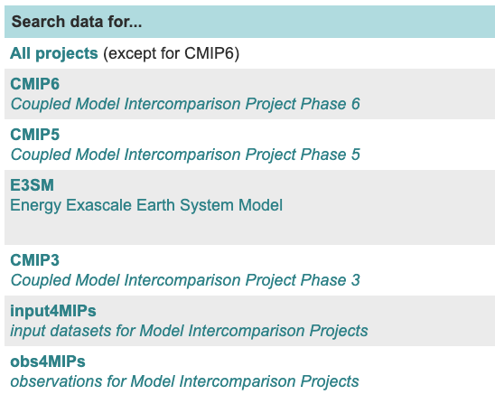
CMIP6 Models data - ESGF portal
> ESGF projets data page - https://esgf-node.llnl.gov/projects/esgf-llnl/
---> https://esgf-node.llnl.gov/projects/cmip6

Slide 5
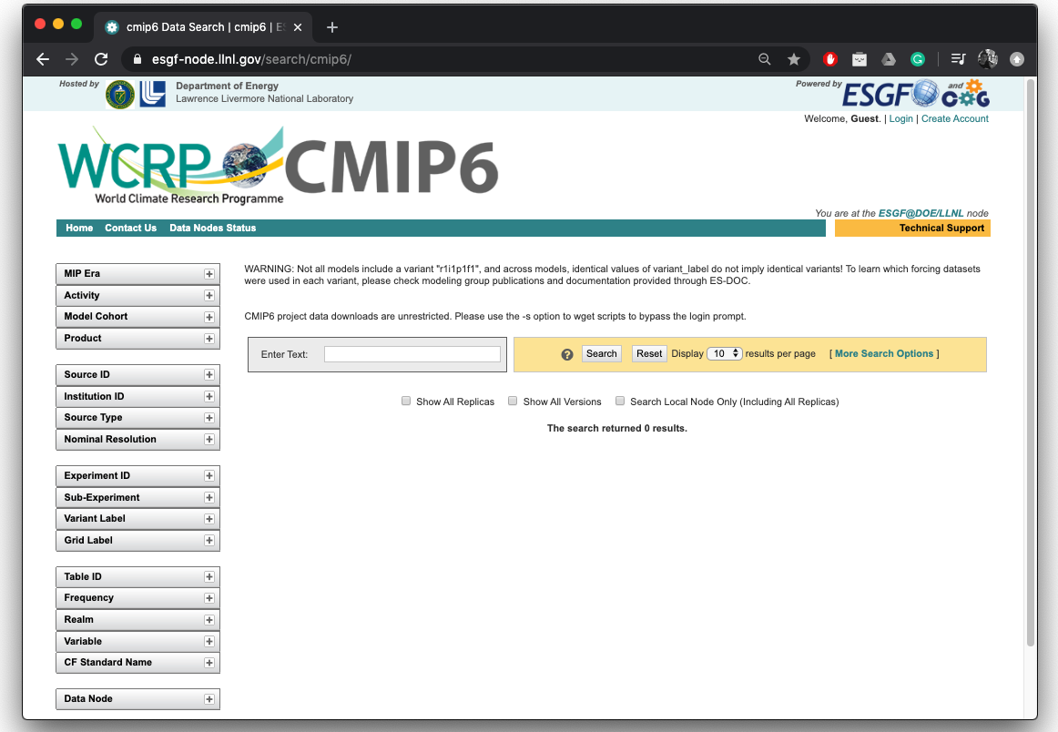
CMIP6 Models data - Data download
> https://esgf-node.llnl.gov/projects/cmip6

Slide 6
CMIP6 Models data - Data download
> https://esgf-node.llnl.gov/projects/cmip6
Example:
Get a climate model temperature output, from scenario SSP585 (High GHGs emissions), for the first realization (r1i1p1f1).

Slide 7
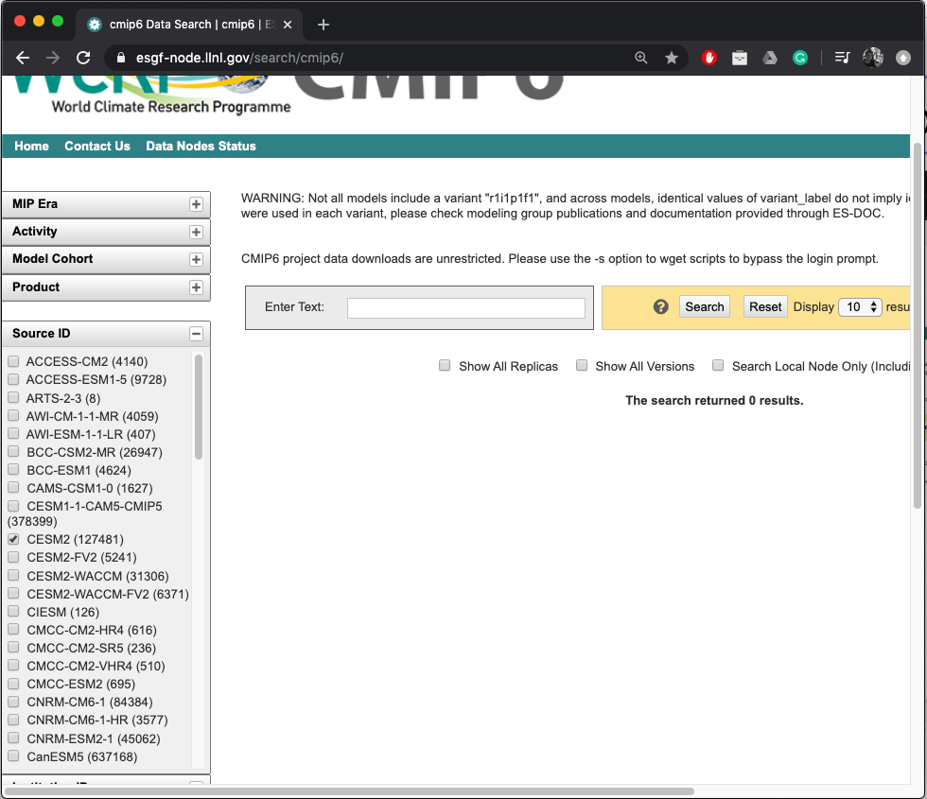
CMIP6 Models data - Data download
> https://esgf-node.llnl.gov/projects/cmip6
Example:
Get a climate model temperature output, from scenario SSP585 (High GHGs emissions), for the first realization (r1i1p1f1).

Slide 8
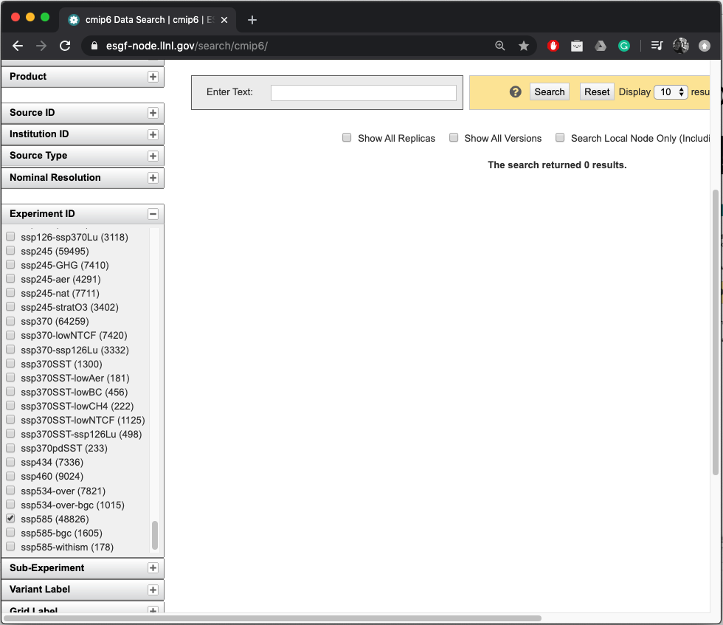
CMIP6 Models data - Data download
> https://esgf-node.llnl.gov/projects/cmip6
Example:
Get a climate model temperature output, from scenario SSP585 (High GHGs emissions), for the first realization (r1i1p1f1).

Slide 9
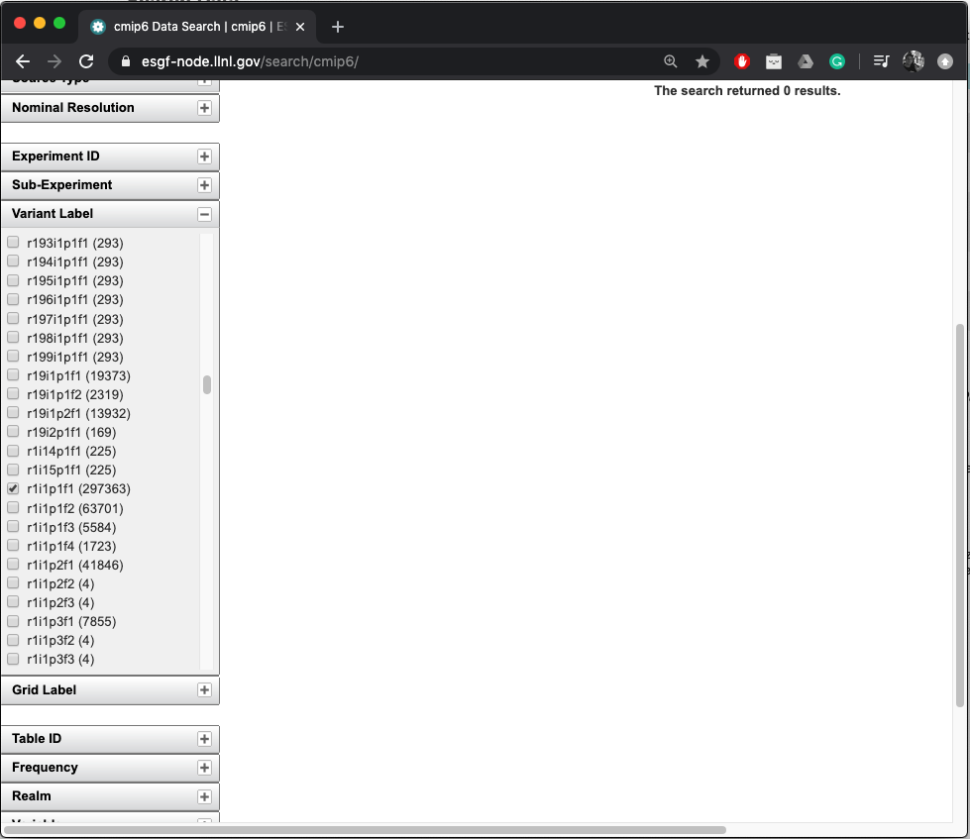
CMIP6 Models data - Data download
> https://esgf-node.llnl.gov/projects/cmip6
Example:
Get a climate model temperature output, from scenario SSP585 (High GHGs emissions), for the first realization (r1i1p1f1).

Slide 10
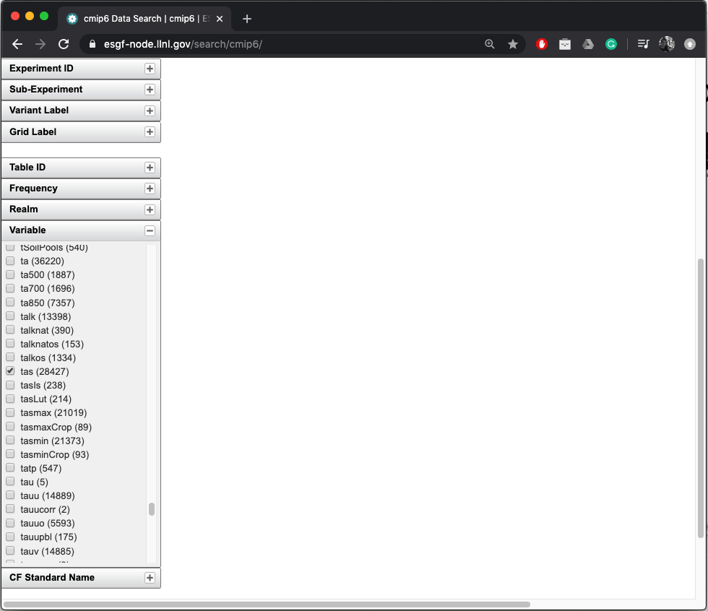
CMIP6 Models data - Data download
> https://esgf-node.llnl.gov/projects/cmip6
Example:
Get a climate model temperature output, from scenario SSP585 (High GHGs emissions), for the first realization (r1i1p1f1).

Slide 11
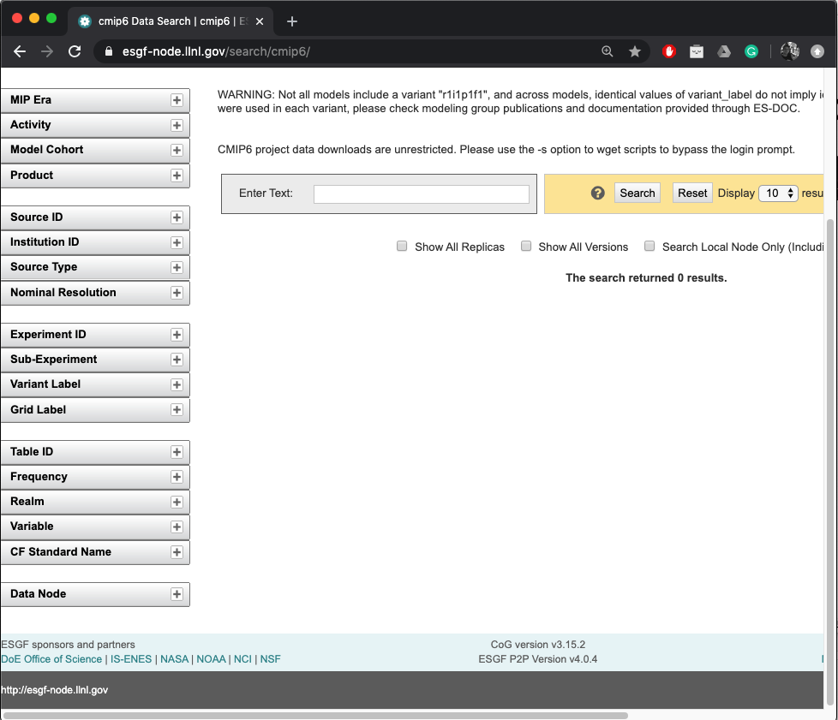
CMIP6 Models data - Data download
> https://esgf-node.llnl.gov/projects/cmip6
Example:
Get a climate model temperature output, from scenario SSP585 (High GHGs emissions), for the first realization (r1i1p1f1).
After selecting the check boxes, press “Search”.

Slide 12
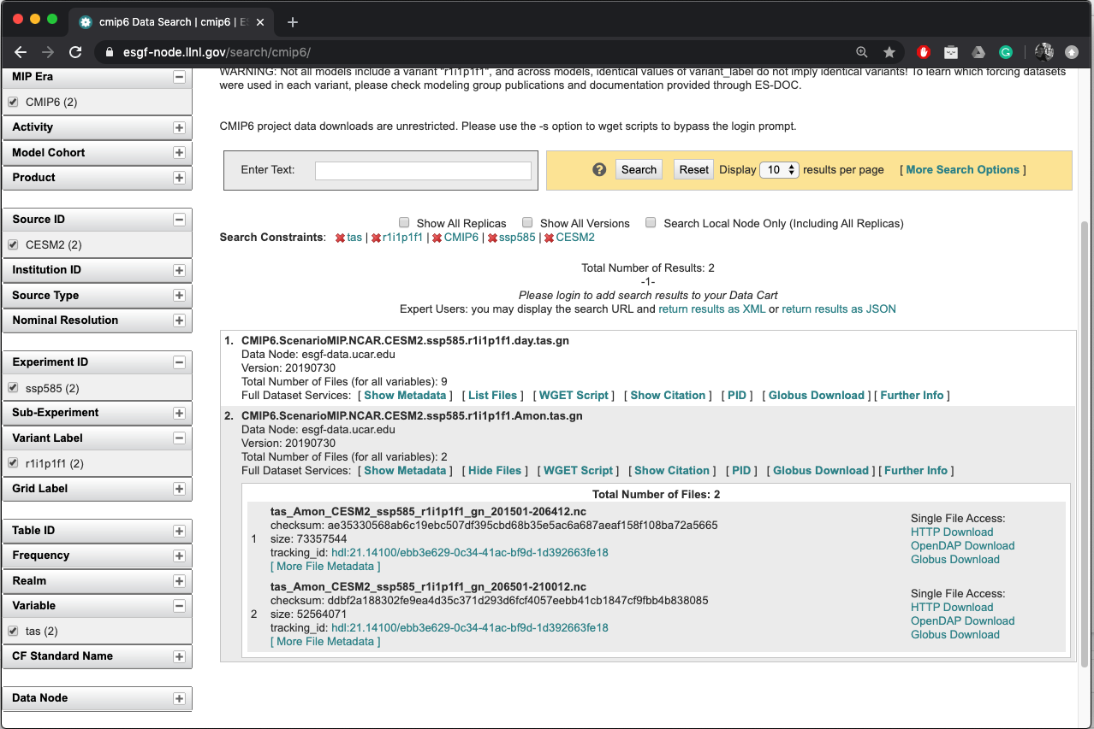
Click “HTTP Download”.
And choose a folder to save the output file.

